Slide 1
CSC 495/563
VR Timeline
Colleen Hutson Ronak Nisher
Juhi Desai Akash Agrawal Hongyi Ma
Kamaria Hardy

Slide 2
Outline
Background & Prompt
Application Features
Demo
Usability Study
Future Work

Slide 3
History & Prompt
Where did the idea come from?
Timeline JS is an open source tool that allows people to create times to view on a laptop/desktop
NC State’s College of Design has a Design History Timeline
Prompt
Bring this time to Virtual Reality

Slide 4
Goal
Allow a user to scroll through timeline with basic head movements
Allow user to see additional information for each event above and below timeline
Allow a user to view different timelines
Implement the application with Unity 3D for use with Google Cardboard

Slide 5
Application Features

Slide 6
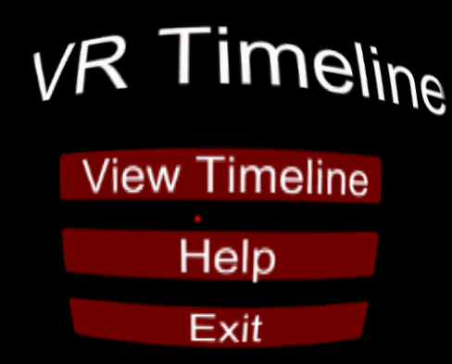
At Launch
Notes:
Upon launching the application the user is presented with two buttons
View Timeline sends the user straight to the Design Timeline
Help sends the user to a screen that provides introduction to the application

Slide 7
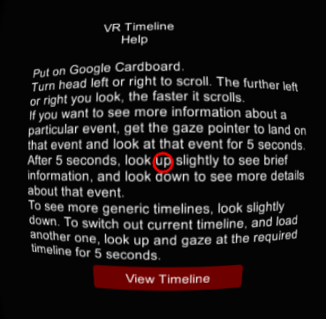
Help Screen
Notes:
The Help Screen provides the user with a text description of how to use and interact with the app. Some of the main points the instructions make are
Clicks or selections are made by a steady gaze that lasts 5 seconds
To scroll through the timeline look to the right or the left
The further left or right you look the quicker the timeline scrolls
To view different timelines select the button below the timeline and then select the timeline you are interested in viewing
After the user reads through the instructions they click the “View Timeline” button and begin the timeline experience

Slide 8
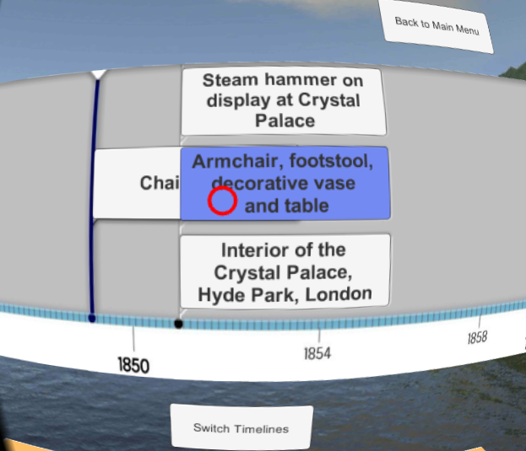
Main Timeline View
Notes:
The user begins in the center of the timeline
As previously mentioned in the Help Screen to scroll through the timeline simply look to the left or right
When your gaze is over an event the button will turn the shade of blue shown above
After holding your gaze for 5 seconds ceiling and floor panels will change to provide additional information on that specific event
Point out the switch timelines and back to main menu button

Slide 9
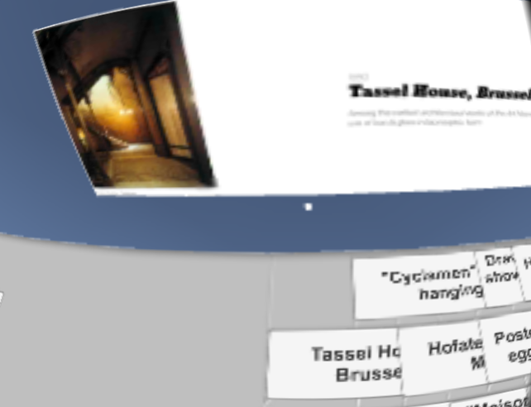
Some Additional Information
Notes:
After clicking on a timeline event the user can look up and see some additional information
This is just a small picture and little blurb about the event
Until the user selects a different event this image will remain

Slide 10
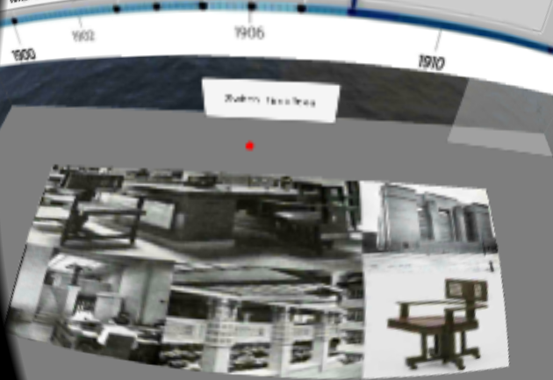
More Additional Info
Notes:
After selecting an event the user can look down and view even more information about the particular event.
This could be multiple pictures or extra text blurbs
For now we have it implemented as a collage of a few pictures
Like the some additional information panel this image will remain until another event is selected

Slide 11
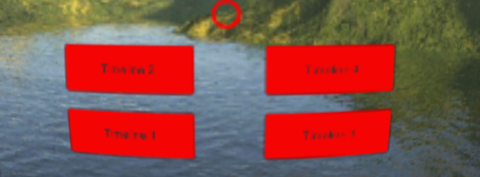
More Timelines
Notes:
At the bottom of the timeline panel is a button to select a different timeline
Upon selecting or triggering it with your gaze the main timeline panel is replaced with a button for each timeline available in the application
Once the user selects the timeline of interest he/she returns to the timeline view

Slide 12
DEMO

Slide 13
Functioning Interactions
Design Timeline
Interface Timeline
Side Chair in Bentwood
Chair no 14
Steam hammer on display at Crystal Palace
Armchair, footstool, decorative vase and table
Interior of Crystal Palace, Hyde Park, London
Grand Staircase, L’Opera, Paris
Brown & Sharpe Universal Milling Machine
Teapot in silver electroplate with ebony handle
Tassel House, Brussels
“Cyclamen” Wall Hanging
Hofatelier Elvira, Munich
Unidentified Engine Room
Maison du Peuple
Writer’s Study
Poster for “Tropon” egg white extract
Drawing of Armchair
Habana Tobacco Co. Showroom, Berlin
Advertisement for AEG Dynamos
Larkin Company Administration Building
Remote Access
ENIAC
UNIVAC I
Multics
Minicomputer
Mouse
Xerox Alto
Apple I
Machintosh
WIndows 1.0
Osborne I
Stylus
Continuous Scrolling
Multi Touch
Speech Recognition
Notes:
What we have implemented
There are two different timelines - Design and User Interface
This slide shows which buttons on the design & interface timeline have interactions implemented - meaning they have some and more additional information panels
But be aware not all of these events have more additional information available. For these we have a place holder image. We have made these place holders in a few different colors to allow you to see the panel image changing when a different button is selected
Larkin Company Administration Building is the only one with actual supplied more information picture

Slide 14
Usability Testing/ User Survey
We asked questions like:
Survey Questionnaire
Number of Participants: 9

Slide 15
Results
Survey results
We concluded that:
Most of the people had not used a VR timeline app before
All participants were satisfied with the user experience
90% of the participants found at least some of the interactions useful
Almost all the participants were willing to try to use this app as well as VR devices in general in the future
Some suggestions were to add more timelines as well as sound

Slide 16
Future Work
Placement of button can be improved
More information section on the bottom can be made into a scrollable photo album instead of a single image
This app can be ported to other use cases like museums and art galleries

Slide 17
Questions???

Slide 18
Thank You!!!

